Slide 1
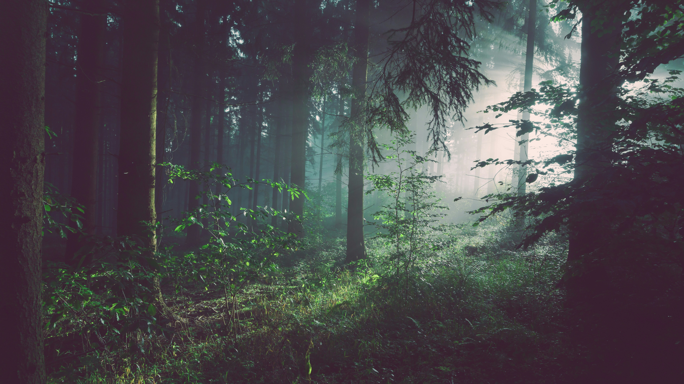

THE WONDERS OF OUR RESOURCES
Forests, Riparian Areas & Wetlands
Conservation of Energy and Resources: E1.1-E1.3 Bruce County Museum & Cultural Centre’s Earth Week 2025
Notes:
I’m Chelsea the Environmental Educator at Grey Sauble

Slide 2

WHY THESE PLACES MATTER
What do forests, riparian areas, and wetlands do for us?
Riparian: the area that connects land and water.
Help store fresh water
Absorb carbon from the air
Provide habitat for local wildlife (helping sustain our native biodiversity)
Give us renewable resources like wood, clean water and air
Notes:
Riparian: relating to or situated on the banks of a watercourse (river, stream or creek).
Wildlife: local aquatic species, mammals, birds, insects, etc.

Slide 3
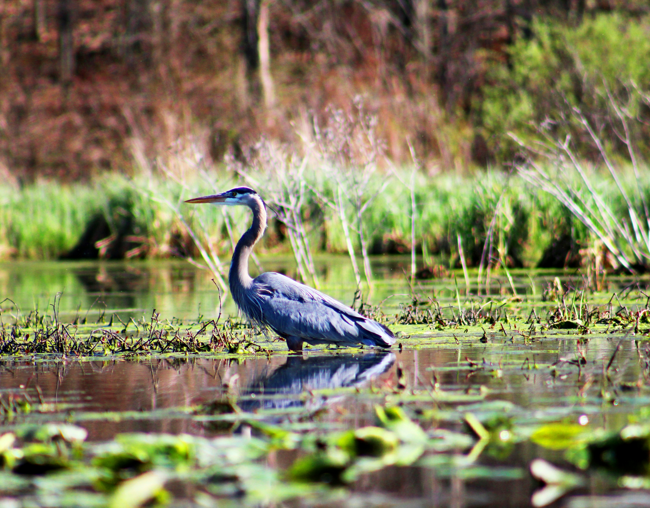
FIGHTING CLIMATE CHANGE
WITH NATURE
Forests/Wetlands - carbon sinks
Wetlands - natural filters and flood/drought mitigators
Riparian areas - protect water and reduce erosion
Together, they help support biodiversity and species conservation, sequester carbon, and cool the planet!
Notes:
Nature does so much for us, but it also plays a crucial role in climate change.
Forests/Wetlands: keep carbon levels lower than what we’d otherwise be facing.
Wetlands as flood/drought mitigators: by storing and slowing down the movement of water across a landscape.

Slide 4
WHAT ARE CONSERVATION
AUTHORITIES?
Grey Sauble is one of 36 Conservation Authorities in Ontario
Protecting, managing and conserving our natural resources
Protect people and property from natural hazards
Help restore and protect natural areas (and their biodiversity!)
Deliver educational programming that helps individuals appreciate their natural environment and embed stewardship into daily life

Slide 5
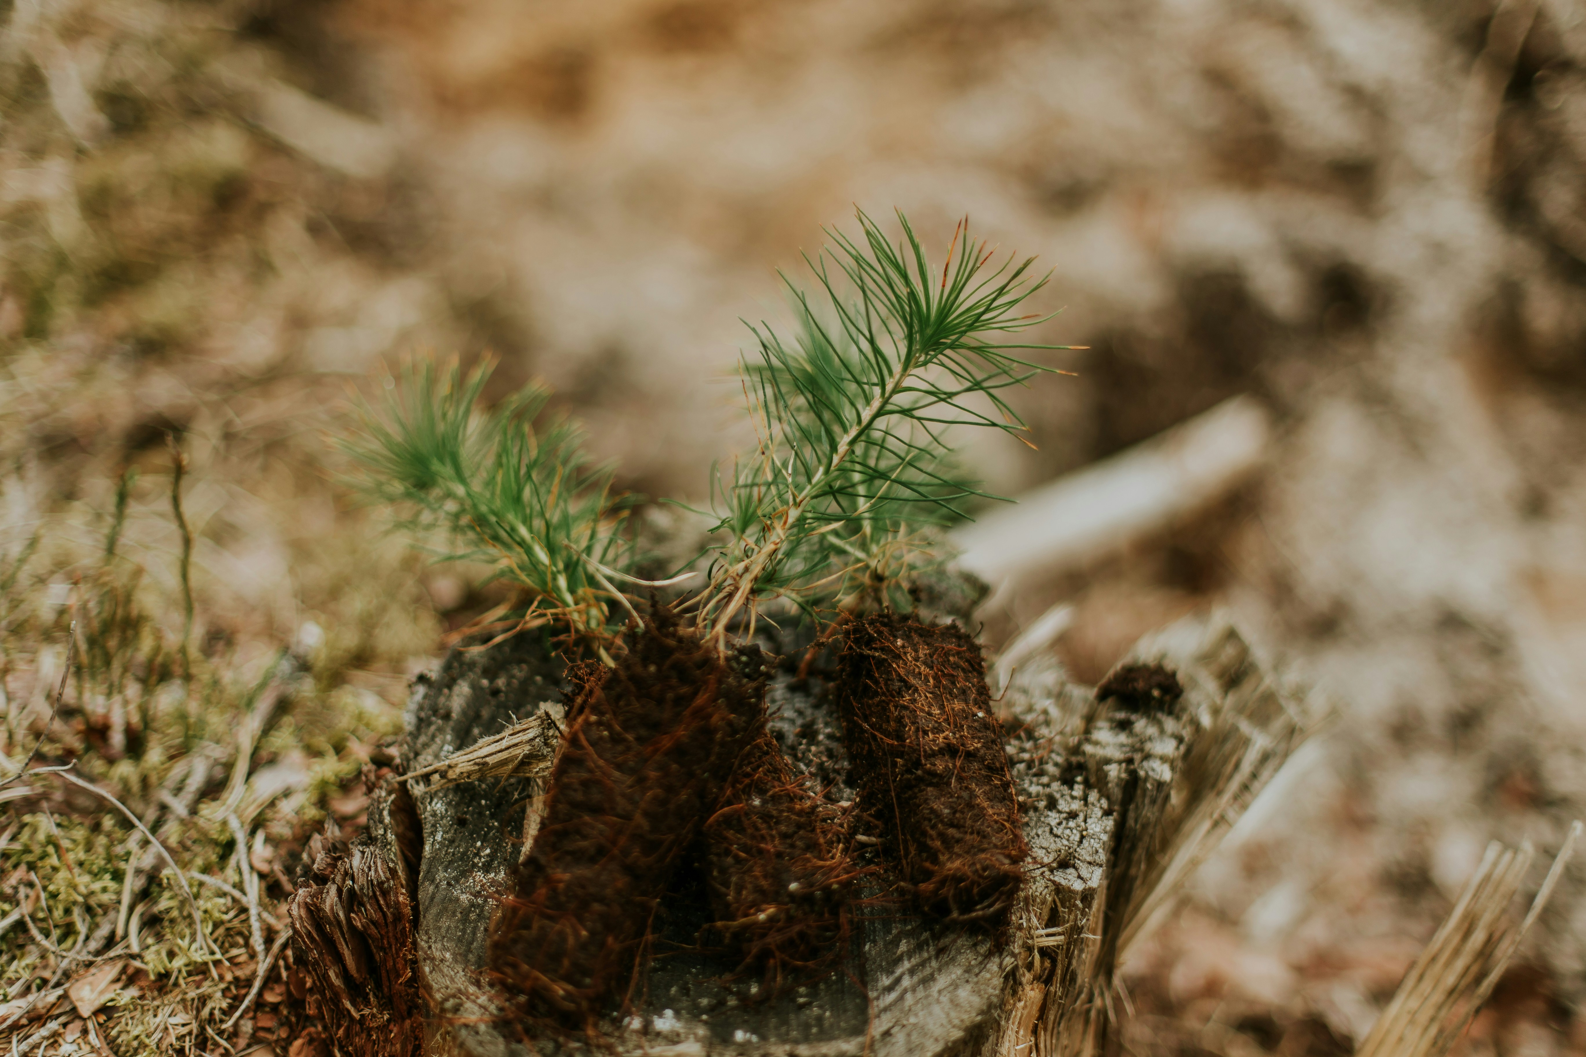
OUR IMPACT, OUR RESPONSIBILITY
How people impact natural resources:
Cutting too many trees
Building on wetlands
Polluting watercourses
BUT… we can help!
Plant trees
Protect water
Reduce energy use

Slide 6
INDIGENOUS KNOWLEDGE
IN ACTION
What can we learn from our Indigenous communities?
How to live in balance with the land
Use only what’s needed
Pass on knowledge through generations

Slide 7
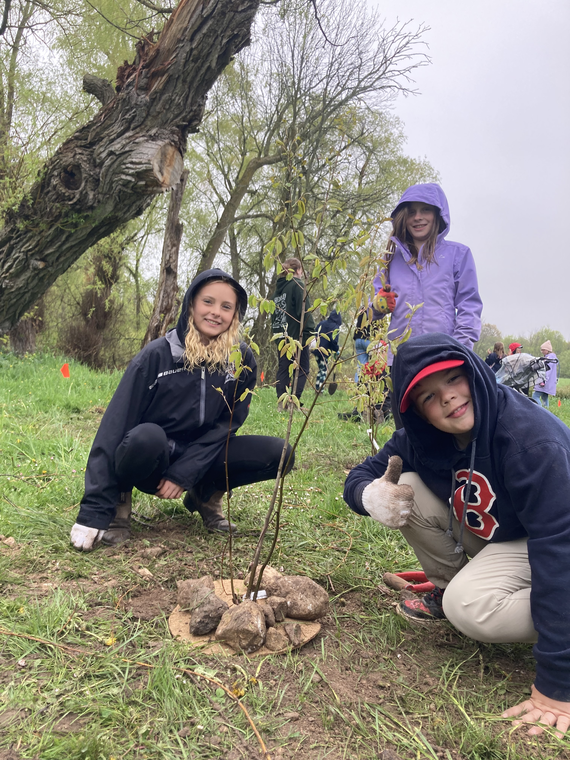
TAKE ACTION!
Your Mission: Plant a native species near…
A watercourse (river, creek, or a stream)
Your schoolyard
Your backyard
Why?
Helps local biodiversity (plants, insects, animals)
Helps sequester carbon (fighting climate change!)
Helps protect our natural resources!
Notes:
Trees for Tara: This project blossomed through a working group of the Youth Climate Action Conference who inspired a group of grade 7 students at Arran-Tara Elementary School to form a Climate Club. Thanks to community support, they raised $1500 to purchase trees, and received a generous donation of 50 trees from the Inglis Fall Arboretum Alliance.
Students, teachers and parent volunteers rolled up their sleeves and planted a diverse mix of 100 native hardwoods and shrubs along the beautiful Sauble River at Tara Dam Conservation Area. What's even more incredible? The grade 7 students took the lead, guiding and inspiring their younger peers from grades 2-4. They all worked hard in the rain to ensure each tree found its new home in the earth.

Slide 8
QUICK RECAP
Nature helps us fight climate change 🌍
Our forests, wetlands, and riparian zones (natural resources) are essential
You can help by planting, learning, and protecting
Conservation Authorities are here to support you!

Slide 9

THANK YOU
Want to learn more?
Visit: greysauble.on.ca
Notes:
To contact Grey Sauble’s education department, contact: education@greysauble.on.ca

